Slide 1
Civil War Books/Movies for Unit Plan
EDU Reading in the Content

Slide 2
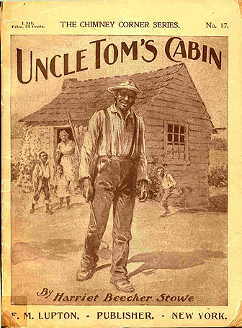
http://d.gr-assets.com/books/1348966625l/1734445.jpg
http://ecx.images-amazon.com/images/I/51G91m1ITtL._SY344_BO1,204,203,200_.jpg
http://ecx.images-amazon.com/images/I/51yRrHfKYtL._SY344_BO1,204,203,200_.jpg
http://ecx.images-amazon.com/images/I/519YQRZAGXL._SX258_BO1,204,203,200_.jpg
http://d.gr-assets.com/books/1355371689l/682804.jpg
http://utc.iath.virginia.edu/uncletom/illustra/figures/cover15.jpg

Slide 3
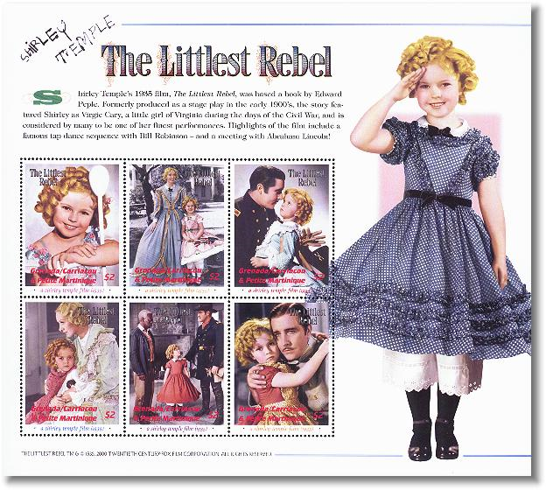
http://www.teachwithmovies.org/guides/gettysburg-files/DVD-cover.jpg
https://resizing.flixster.com/VtqrgDP-HQhvVlSy0BSqcJQvgMM=/800x1200/v1.bTsxMTE2ODA5MjtqOzE3MDQxOzIwNDg7ODAwOzEyMDA
http://stamp-search.com/images/grs0118sh2-littlest6rebel.jpg

