Slide 1
Lewis and Clark Expedition Unit

Slide 2
Louisiana Purchase 1803
https://s-media-cache-ak0.pinimg.com/originals/b4/ed/4f/b4ed4fb8a25d8e48ce81c6c9a10424e0.jpg

Slide 3
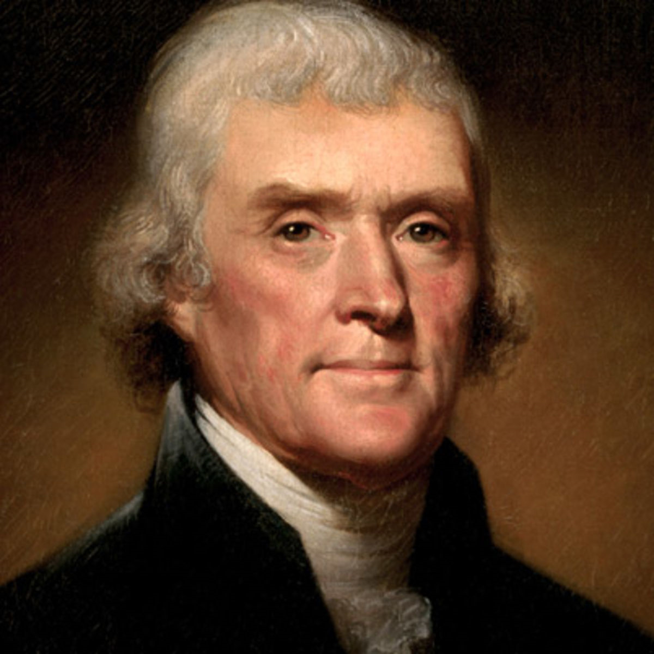
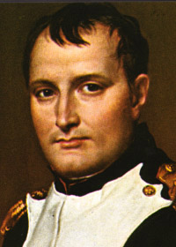
Figures of the Louisiana Purchase
Thomas Jefferson
Napoleon Bonaparte
http://a1.files.biography.com/image/upload/c_fit,cs_srgb,dpr_1.0,h_1200,q_80,w_1200/MTE5NDg0MDU1MDEwMjQ4MjA3.jpg
http://www.nndb.com/people/116/000050963/napoleon4.jpg

Slide 4
Lewis and Clark
Left – Lewis
Right – Clark
http://diyhomeschooler.com/wp-content/uploads/2014/03/hslc1.jpg

Slide 5
Lewis and Clark trail
http://www.pbs.org/lewisandclark/archive/map2_b.html

Slide 6
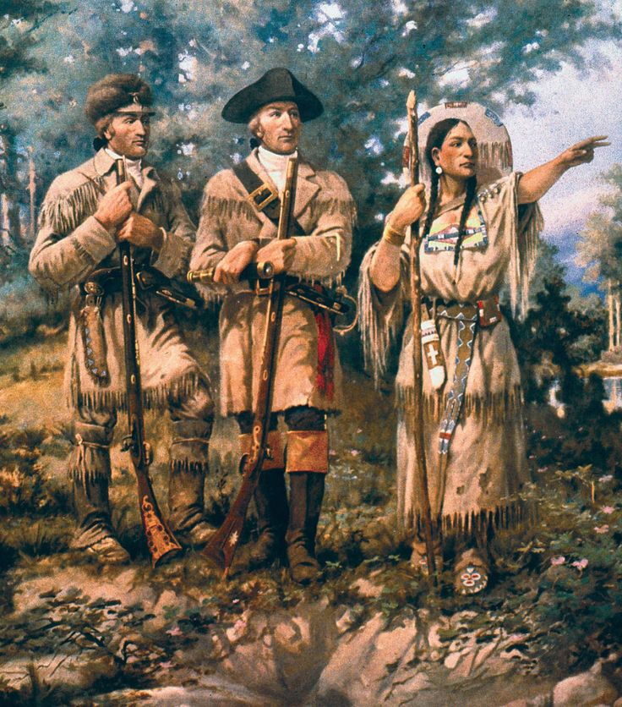
Sacagawea/Sakakawea
http://www.who2.com/wp-content/uploads/2015/10/sacagawea-coin-front-mint-272x272.jpg
https://s-media-cache-ak0.pinimg.com/736x/85/51/2e/85512eb598264b58dcb1944ea7560f8a.jpg

Slide 7
Animated Map
https://www.youtube.com/watch?v=vkeOkEkmbE8
(Note: The ending date of the Expedition on this video says 1803. This is incorrect.)
Lewis and Clark Parody
https://www.youtube.com/watch?v=NB1GQRVG9Fc

Slide 8
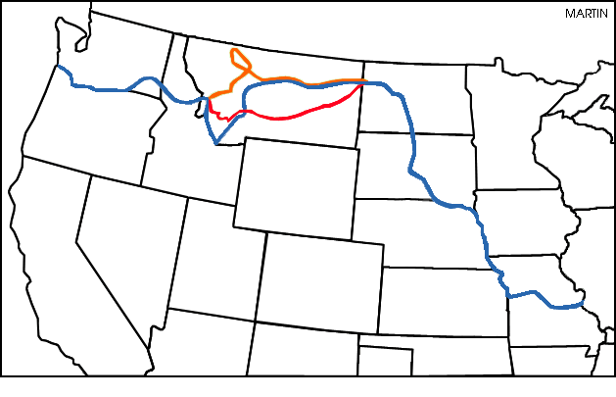
http://states.phillipmartin.info/missouri/lewis_clark_trail_coloring.htm

Slide 9
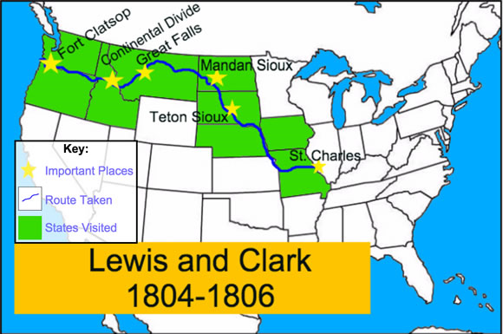
http://mrnussbaum.com/lewis_clark/lcmap2.jpg

